Slide 1

COVID-19 Data Analysis : Cases Reported Investigation and Reporting
By Dipal Paneri

Slide 2
What is COVID-19?
Coronavirus Disease 19 or COVID-19 is a disease of the upper respiratory system. Infectious and contagious, COVID-19 is caused by a type of virus belonging to the Coronavirus group, SARS-CoV-2 (severe acute respiratory syndrome coronavirus 2).
COVID-19 is the infectious disease caused by the most recently discovered coronavirus. This new virus and disease were unknown before the outbreak began in Wuhan, China, in December 2019. COVID-19 is now a pandemic affecting many countries globally.
ORIGIN
Being a betacoronavirus like MERS-CoV and SARS-CoV, SARS-CoV-2 also has its origin in bats. An initial find suggested an animal-to-person transmission of the virus, however, the current spread owes to person-to-person transmission.

Slide 3
Table of contents
01
02
03
Data Profiling
Data Cleaning
Data Processing
04
05
Data Analysis
Insights
Get The No. Of Rows and Columns Available in dataset
Check dataset for correct Datatypes, Empty /Null Values, Date Format Correction
Replace the Null Values with appropriate values, in Numeric mostly with 0
Querying for Key Performance Indicator’s (KPIs), Measures and Metrics to evaluate the Questions
Insights of key findings based on the Data Analysis done in SQL along with Recommendations/Suggestions

Slide 4

Introduction
The objective of this project is to analyze the spread of the COVID-19 virus using a dataset containing information about confirmed cases, deaths, and recoveries.
By conducting data analysis using SQL, we aim to derive data-driven insights to understand the spread of the virus over time and across different geographic regions.

Slide 5
Identifying information Provided in Dataset
Province
Country_Region
Date
Confirmed
Deaths
Recovered
Longitude
Latitude

Slide 6
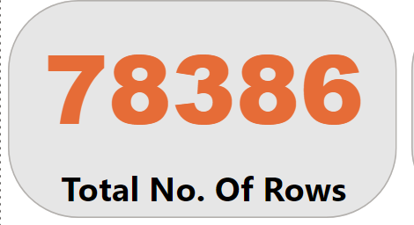
Data Profiling
SELECT COUNT(*) AS Total_No_Rows
FROM corona.dbo.Covid19Data
Total No. of Rows : 78386
Columns : 8 Fields

Slide 7

Data Cleaning – Checking for Null Values
SELECT *
FROM corona.dbo.Covid19Data
WHERE
Province IS NULL OR
Country_Region IS NULL OR
Latitude IS NULL OR
Longitude IS NULL OR
Date IS NULL OR
Confirmed IS NULL OR
Deaths IS NULL OR
Recovered IS NULL;
The Empty Table with No record shows there are no Null Values in the table

Slide 8
Data Cleaning – Updating the Null Values
UPDATE corona.dbo.Covid19Data
SET
Province=COALESCE(Province, '0’),
Country_Region=ISNULL(Country_Region,'0'),
Latitude=ISNULL(Latitude, '0'),
Longitude=ISNULL(Longitude, '0’),
Date=ISNULL(Date, '0'),
Confirmed=ISNULL(Confirmed, '0'),
Deaths=ISNULL(Deaths, '0'),
Recovered=ISNULL(Recovered, '0')
The ISNULL() method is used to replace all the null values with 0.
COALESCE() method provides the same result as ISNULL() method.

Slide 9
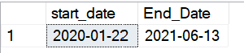
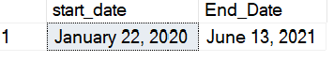
When Covid-19 First Reported And The Tracking end Date
SELECT
MIN(Date) AS Start_Date,
MAX(Date) AS End_Date
FROM Covid19Data
SELECT
FORMAT(MIN(Date), 'MMMM dd, yyyy')AS start_date,
FORMAT(MAX(Date), 'MMMM dd, yyyy')AS End_Date
FROM corona.dbo.Covid19Data;
2021
2020
End Date
13th June 2021
Start Date
22nd January 2020
The Time Line shows data worth of 18 months and which is a year 2020 - 2021

Slide 10
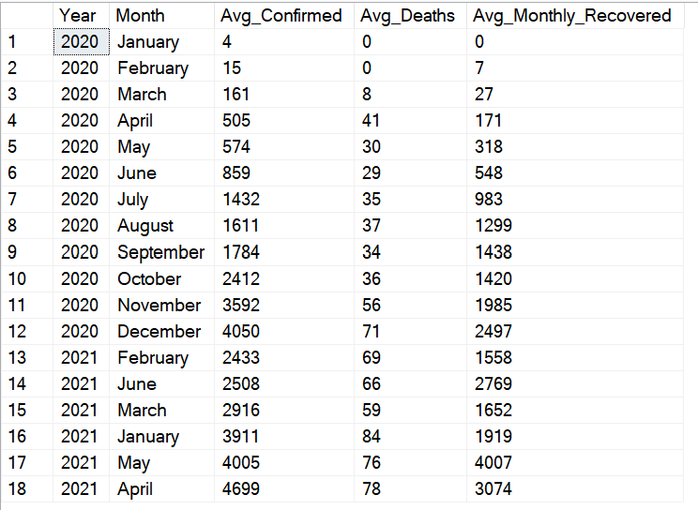
SELECT YEAR(Date) AS Year, DATENAME(MONTH, Date) AS Month, AVG(Confirmed) AS Avg_Confirmed, AVG(Deaths) AS Avg_Deaths, AVG(Recovered) AS Avg_Monthly_Recovered FROM Covid19Data WHERE YEAR(Date) IN (2020, 2021) GROUP BY YEAR(Date), DATENAME(MONTH, Date) ORDER BY YEAR(Date), Avg_Confirmed, Avg_Deaths, Avg_Monthly_Recovered, Month;
Monthly Average for Confirmed Cases, Deaths, Recovered Cases

Slide 11
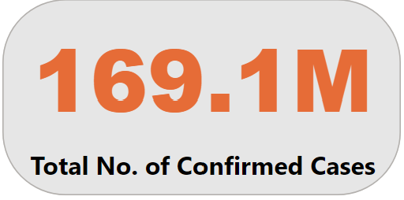
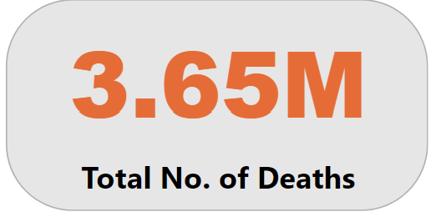
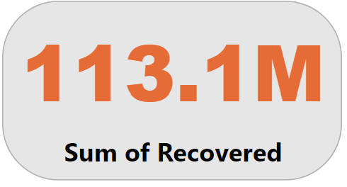
Case Details in depth
Confirmed cases
Deaths
Recovered Cases

Slide 12
Most Frequent Value of Confirmed Cases, Deaths and Recovered Cases Each Month
WITH MonthlyData AS (
SELECT
DATENAME(MONTH, Date) AS Month,
YEAR(Date) AS Year,
Confirmed, Deaths, Recovered,
ROW_NUMBER() OVER (PARTITION BY DATENAME(MONTH, Date), YEAR(Date) ORDER BY COUNT(*) DESC) AS RN
FROM Covid19Data
GROUP BY
DATENAME(MONTH, Date),
YEAR(Date),
Confirmed, Deaths, Recovered
)
SELECT
Month, Year, Confirmed, Deaths, Recovered,
COUNT(*) AS Frequency
FROM MonthlyData
WHERE RN = 1
GROUP BY Month, Year,
Confirmed, Deaths, Recovered
ORDER BY Year, Month;
In this Query to populate Most Frequent Value of Confirmed Cases along with Death and Recovered cases,
I used Common Table Expression(CTE) which makes queries more manageable, Less complex and provides opportunity to reference it multiple times in the same sessions.

Slide 13

Other dimensions of measuring Most frequent Value, Minimum Value And Maximum Value of Confirmed Cases, Deaths And Recovered Cases

Slide 14
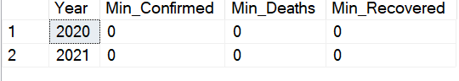
Minimum Value for Confirmed Cases, Deaths and Recovered Cases
SELECT
YEAR(Date) AS Year,
MIN(Confirmed) AS Min_Confirmed,
Min(Deaths) AS Min_Deaths,
MIN(Recovered) AS Min_Recovered
FROM Covid19Data
WHERE YEAR(Date) IN (2020, 2021)
GROUP BY
YEAR(Date)
ORDER BY
YEAR(Date);

Slide 15
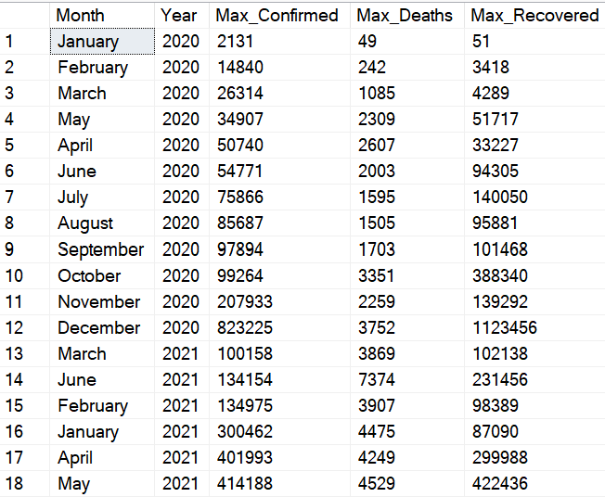
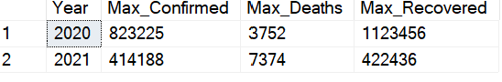
Maximum Value for Confirmed Cases, Deaths and Recovered Cases
SELECT DATENAME(MONTH, Date) AS Month,
YEAR(Date) AS Year,
MAX(Confirmed) AS Max_Confirmed,
MAX(Deaths) AS Max_Deaths,
MAX(Recovered) AS Max_Recovered
FROM Covid19Data
GROUP BY DATENAME(MONTH, Date),
YEAR(Date)
ORDER BY YEAR(Date),
Max_Confirmed, Max_Deaths, Max_Recovered,
MONTH;

Slide 16
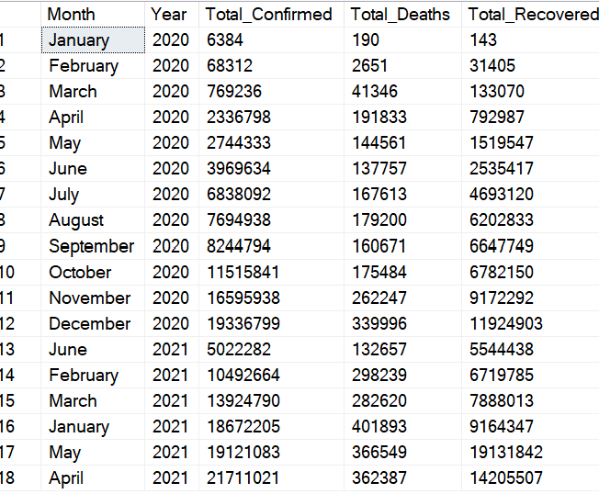
Total No. Of Confirmed Cases, Deaths and Recovered Cases
Each Month
SELECT DATENAME(MONTH, Date) AS Month,
YEAR(Date) AS Year,
SUM(Confirmed) AS Total_Confirmed,
SUM(Deaths) AS Total_Deaths,
SUM(Recovered) AS Total_Recovered
from Covid19Data
WHERE YEAR(Date) IN (2020, 2021)
GROUP BY DATENAME(MONTH, Date),
YEAR(Date)
ORDER BY YEAR(Date),
Total_Confirmed,
Total_Deaths,
Total_Recovered,
MONTH;

Slide 17
Metrics on How Corona Virus Spreads

Slide 18
Corona virus spread out with respect to
Confirmed Cases
SELECT SUM(Confirmed) AS Total_ConfirmedCases,
AVG(Confirmed) AS AVG_ConfirmedCases,
VAR(Confirmed) AS Variance_ConfirmedCases,
STDEV(Confirmed) AS STDev_ConfirmedCases
FROM Covid19Data

Slide 19
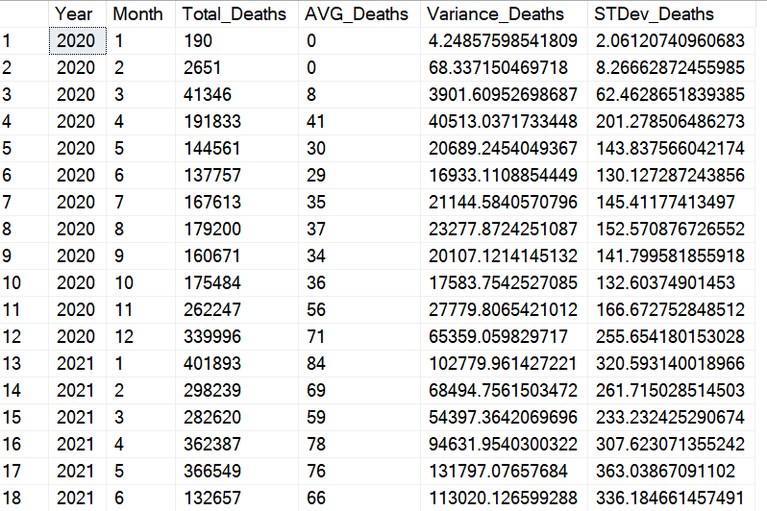
Corona virus spread out with respect to
Deaths by each Month
SELECT YEAR(Date) AS Year,
DATEPART(MONTH,Date) AS Month,
SUM(Deaths) AS Total_Deaths,
AVG(Deaths) AS AVG_Deaths,
VAR(Deaths) AS Variance_Deaths,
STDEV(Deaths) AS STDev_Deaths
FROM Covid19Data
WHERE Year(Date) IN (2020,2021)
GROUP BY DATEPArt(MONTH,Date), YEAR(Date)
ORDER BY Year, Month, Total_Deaths, Avg_Deaths, Variance_Deaths, STDev_Deaths;

Slide 20
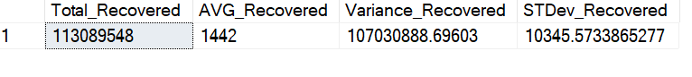
Corona virus spread out with respect to
Recovered Cases
SELECT
SUM(Recovered) AS Total_Recovered,
AVG(Recovered) AS AVG_Recovered,
VAR(Recovered) AS Variance_Recovered,
STDEV(Recovered) AS STDev_Recovered
FROM Covid19Data

Slide 21
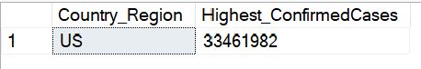
Map of Country with Highest cases Reported
Country With Most Cases
United States
33.46M cases
SELECT TOP 1 Country_Region,
SUM(Confirmed) AS Highest_ConfirmedCases
FROM Covid19Data
GROUP BY Country_Region
ORDER BY Highest_ConfirmedCases DESC;

Slide 22
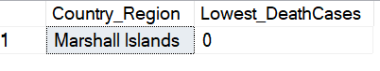
Map of Country with Lowest Deaths Reported
Country With least Deaths
Marshall Island
0 Deaths
SELECT TOP 1 Country_Region,
SUM(Deaths) AS Lowest_DeathCases
FROM Covid19Data
GROUP BY Country_Region
ORDER BY Lowest_DeathCases ASC

Slide 23
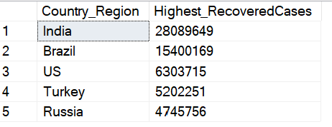
Map of Countries With highest Recovered Cases Registered
SELECT TOP 5 Country_Region,
SUM(Recovered) AS Highest_RecoveredCases
FROM Covid19Data
GROUP BY Country_Region
ORDER BY Highest_RecoveredCases DESC;

Slide 24
Map of Top 5 countries with Highest Recovered Cases
USA
Turkey
6.30M
5.20M
Brazil
Russia
15.40M
4.75M
India
28.09M

Slide 25

Insights
Technical Findings
No Null Values in the dataset.
Total No. Of Rows in Data set : 78386
Total No. Of Columns : 8
Key Findings
Start Date : 22nd January 2020
End Date : 13th June 2021
The Months Of Data available : 18 Months
Total Confirmed cases : 169.06M
Total Deaths Registered : 36.47M
Total Recovered Cases : 113.09M
Country Wise Data
Highest Cases Reported : United States 33.46M
Lowest Deaths Reported : Marshal island with 0
Top Countries with Most Recovered Cases: India, Brazil, USA, Turkey and Russia

Slide 26
Thanks!
Do you have any questions?
Paneri.dipal@yahoo.com
This Project is a Part of @Mentorness Internship Program.

